Slide 1
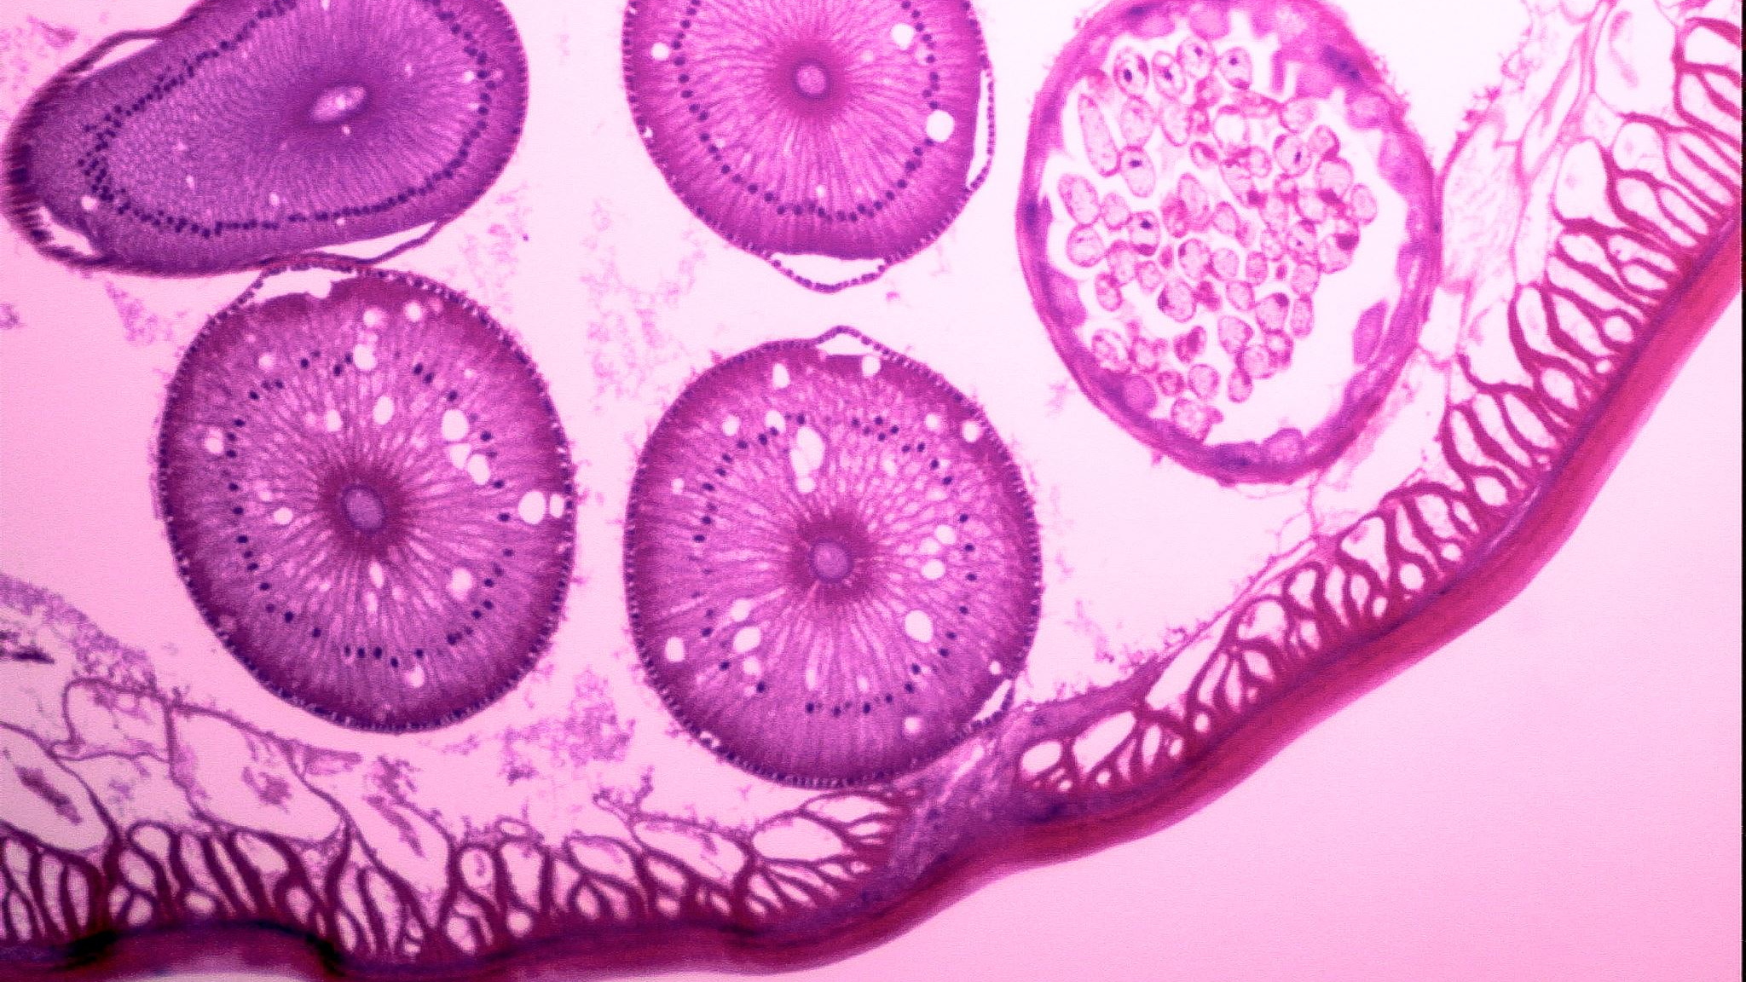
Lung Cancer
An Analysis of PatientS Data and Health Outcome

Slide 2
CONTRIBUTION
RAKESH BATHINI
SQL TABLE CREATION,INSERTION AND TRIGGERING
S
S
S

Slide 3
OBJECTIVE
Creation of new Tables
Creation of new Columns
Table creation and insertion in SQL
Normalization
Framing and answering SQL questions
Data Analysis
Data Visualization
Answering Research Questions

Slide 4
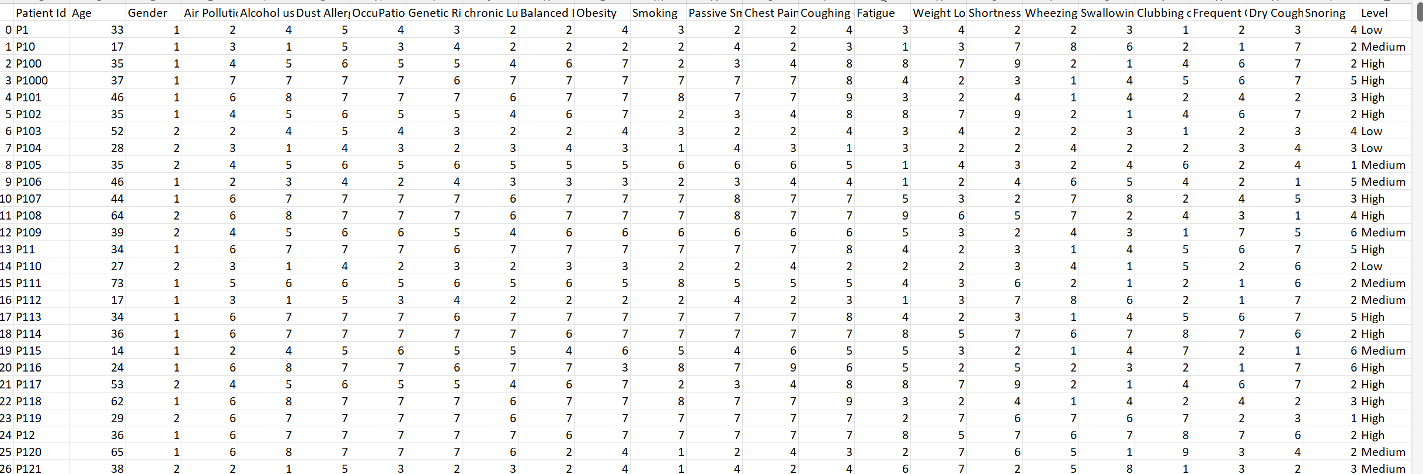
CREATION OF TABLES
ORIGINALDATASET
PATIENT_MAIN
SYMPTOMS
MEDICAL_HISTORY

Slide 5
CREATION OF TABLES
MEDICAL_HISTORY_SCORE
PATIENT_MAIN
PROCEDURE_SYMPTOM_SCORE
SYMPTOMS
SYMPTOM_CHECK
MEDICAL_HISTORY

Slide 6
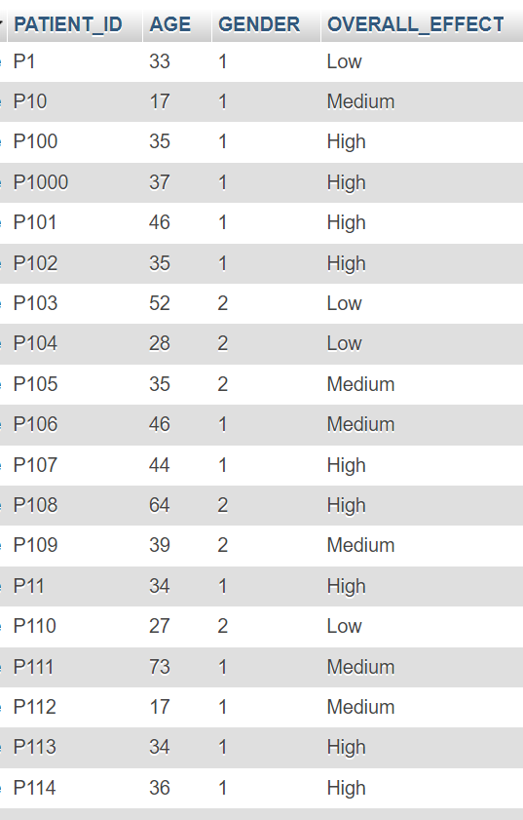
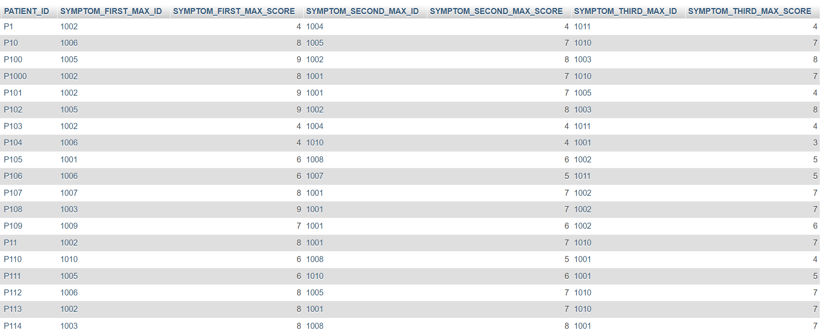
CREATION OF TABLES
PATIENT MAIN
PATIENT SYMPTOM SCORE - Subtype
PATIENT_SYMPTOM_SCORE

Slide 7
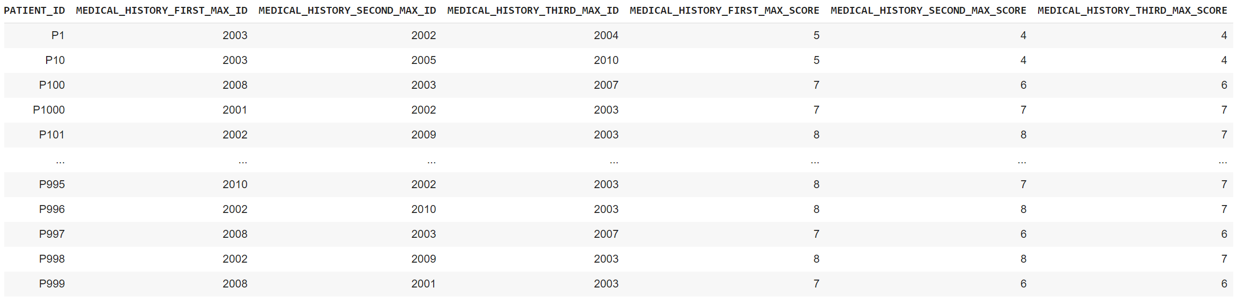
CREATION OF TABLES
PATIENT_MEDICAL_HISTORY_SCORE

Slide 8
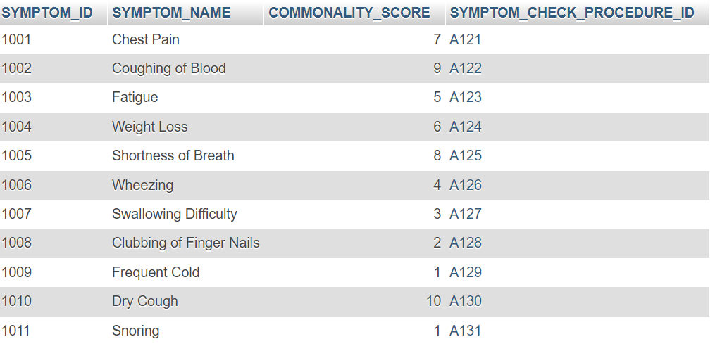
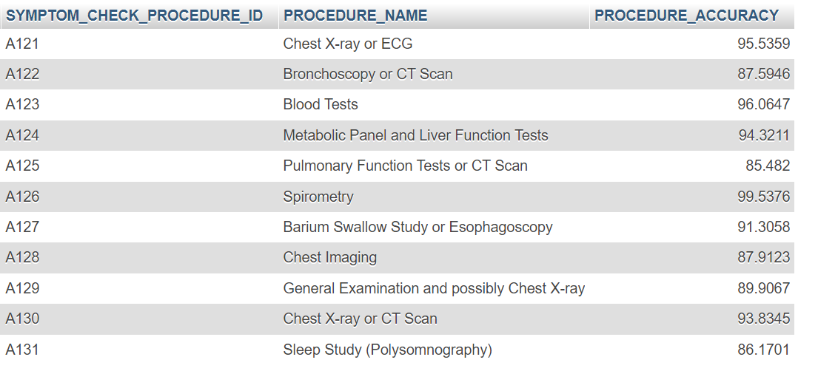
CREATION OF TABLES
SYMPTOMS TABLE
SYMPTOM_CHECK TABLE

Slide 9
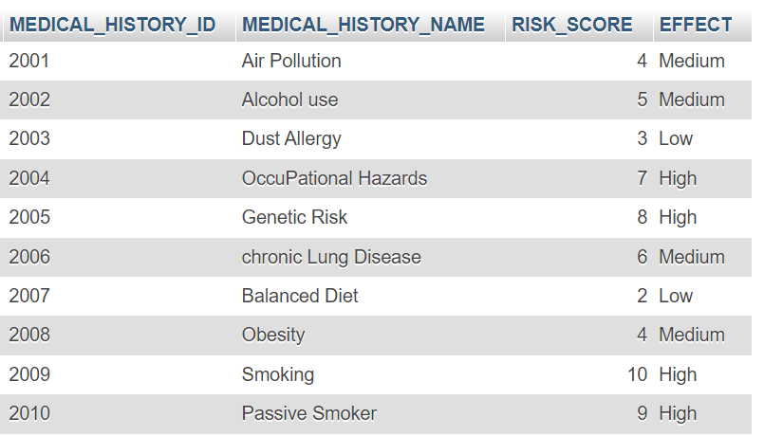
CREATION OF TABLES
MEDICAL HISTORY TABLE

Slide 10

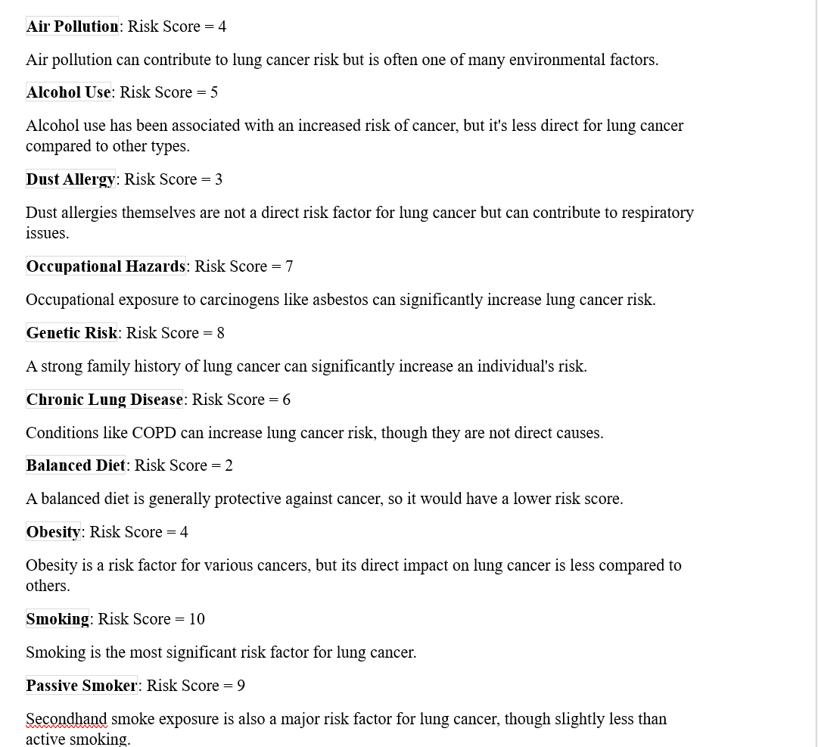
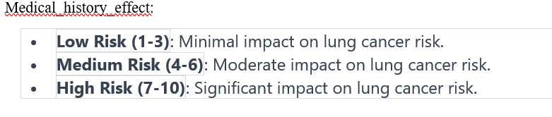
CREATION OF NEW COLUMNS
Done in Medical History table
The Risk scores are effective way to figure out medical histories.
Surrogate key like medical_history_ID is created.
Medical history effect is also added

Slide 11
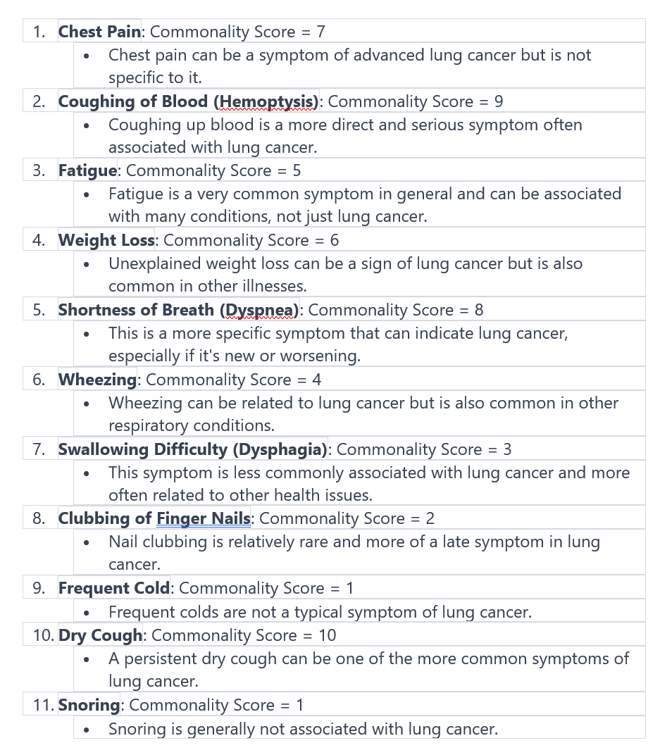
CREATION OF NEW COLUMNS
Done in Symptoms table
The commonality scores are effective way to figure out symptoms.
Surrogate key like symptom_ID is created.

Slide 12
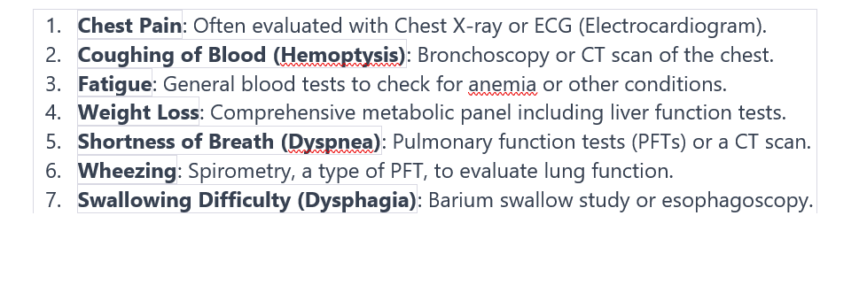
CREATION OF NEW COLUMNS
Done in Symptom_check table
The system check procedures are included.
Surrogate key like symptom_check_ID is created as primary key.

Slide 13

DATA VISUALIZATION

Slide 14
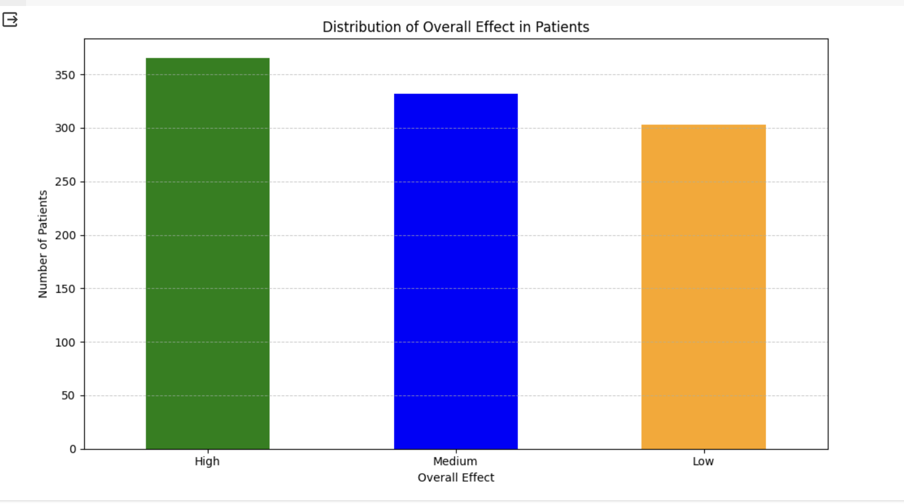
What is the distribution of patients' health outcomes as categorized by 'High', 'Medium', and 'Low' overall effects within a medical dataset?

Slide 15
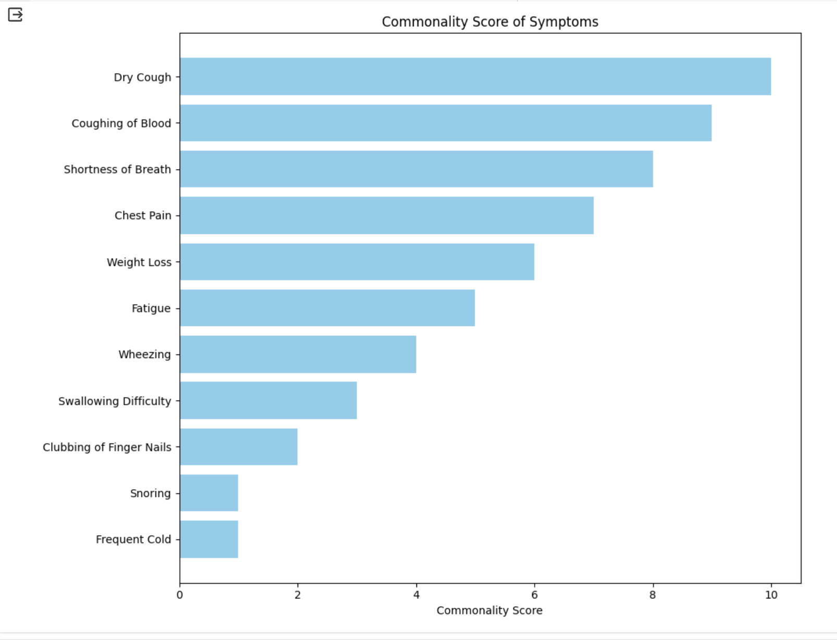
What is the commonality of each symptom presented in the dataset, and which symptoms are most frequently observed according to their commonality scores?

Slide 16
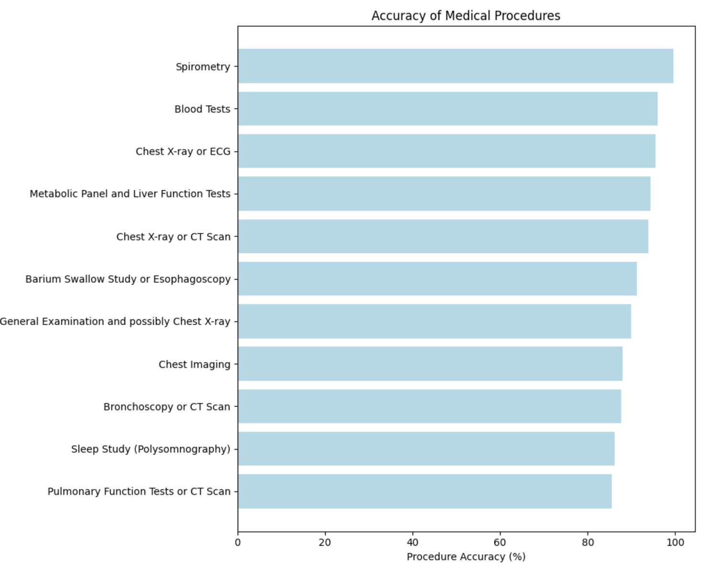
Which medical procedures have the highest accuracy rates according to the dataset, and how do these rates compare across different diagnostic tests?

Slide 17
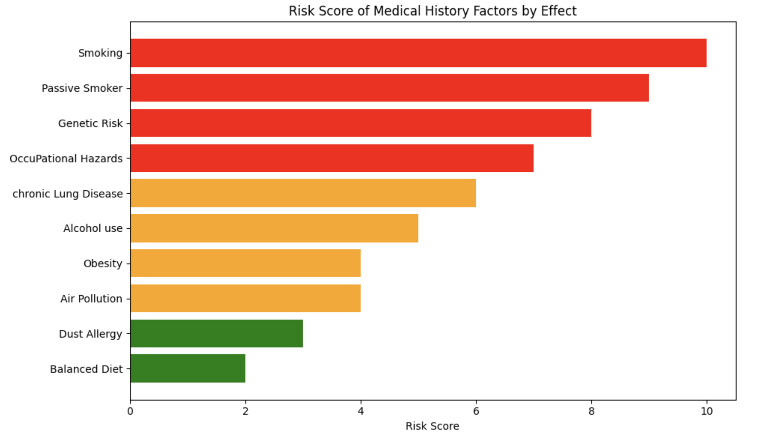
How do different medical history factors compare in terms of risk score, and which factors are identified as having the highest impact on health according to the dataset?

Slide 18
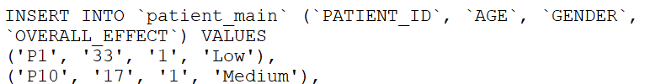
Table creation and insertion in SQL
CREATE TABLE PATIENT_MAIN
( PATIENT_ID varchar(255) PRIMARY KEY NOT NULL,
AGE varchar(255) NOT NULL, GENDER varchar(255) NOT NULL,
OVERALL_EFFECT varchar(255) NOT NULL );
CREATE TABLE PATIENT_SYMPTOM_SCORE
( PATIENT_ID varchar(255) NOT NULL, SYMPTOM_FIRST_MAX_ID varchar(255) NOT NULL,
SYMPTOM_FIRST_MAX_SCORE int NOT NULL, SYMPTOM_SECOND_MAX_ID varchar(255) NOT NULL,
SYMPTOM_SECOND_MAX_SCORE int NOT NULL, SYMPTOM_THIRD_MAX_ID varchar(255) NOT NULL,
SYMPTOM_THIRD_MAX_SCORE int NOT NULL, PRIMARY KEY (PATIENT_ID), FOREIGN KEY (PATIENT_ID) REFERENCES PATIENT_MAIN(PATIENT_ID),
FOREIGN KEY (SYMPTOM_FIRST_MAX_ID) REFERENCES SYMPTOMS(SYMPTOM_ID), FOREIGN KEY (SYMPTOM_SECOND_MAX_ID) REFERENCES SYMPTOMS(SYMPTOM_ID),
FOREIGN KEY (SYMPTOM_THIRD_MAX_ID) REFERENCES SYMPTOMS(SYMPTOM_ID) );
Patient_main and Patient symptom score is created
Similarly other tables are also created
INSERTION is also done.

Slide 19
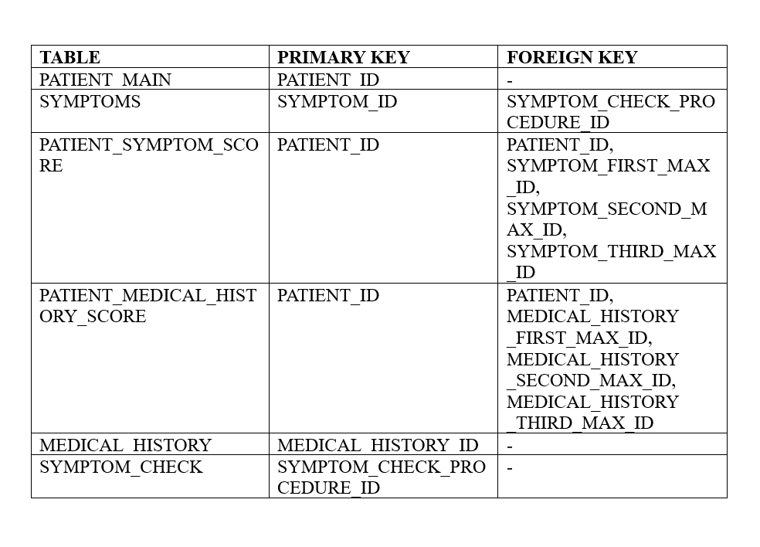
Table creation and insertion in SQL

Slide 20
TRIGGERING
DELIMITER $$
CREATE TRIGGER CheckSymptomFirstMaxScore
BEFORE INSERT ON patient_symptom_score
FOR EACH ROW
BEGIN
IF NEW.SYMPTOM_FIRST_MAX_SCORE > 10 THEN
SIGNAL SQLSTATE '45000’
SET MESSAGE_TEXT = 'Error: The SYMPTOM_FIRST_MAX_SCORE cannot be greater than 10.’;
END IF;
END;
$$ DELIMITER ;
This triggering checks score inserted is below 10 if not raises error.

Slide 21
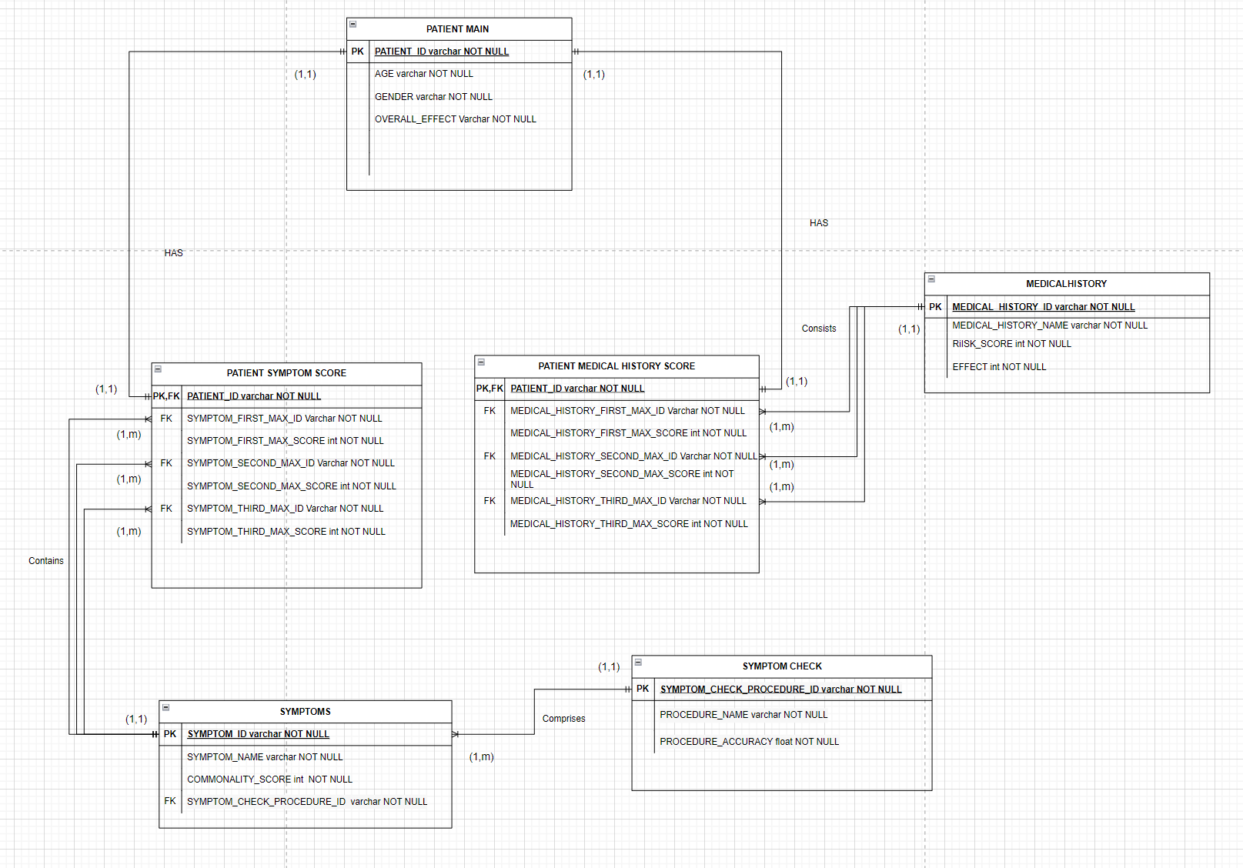
ERD DIAGRAM

Slide 22
ERD BUSINESS RELATION
One patient contains only one first maximum symptoms but one symptom is contained by many patients.
One patient consists only one first maximum medical history but a medical history is may exist for many patients
One symptom consists of one procedure but a procedure or test may be done for many symptoms
One patient has one patient fist maximum symptom score and one firstmaximum symptom score is given to a patient.

Slide 23
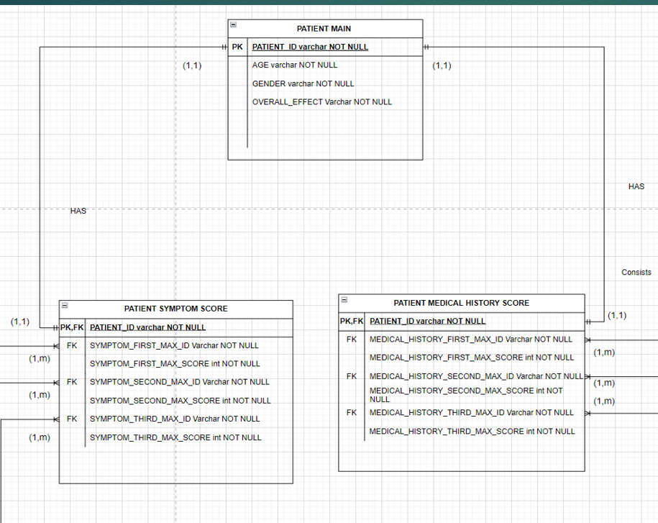
ERD
It has one to one relation for both tables
Cardinality of 1

Slide 24
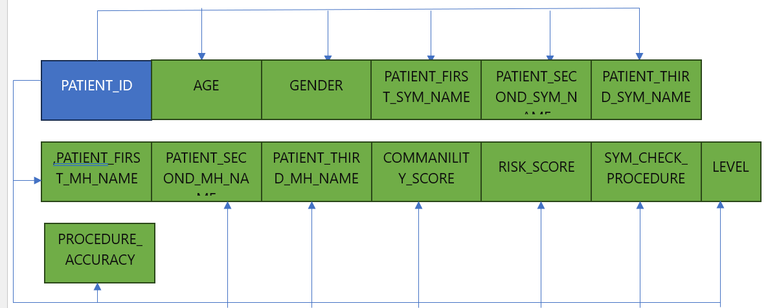
NORMALIZATION
1NF
PATIENT ORIGINAL
All are Transitive Dependencies
PATIENT_ID->(AGE,GENDER,PATIENT_FIRST_SYM_NAME,PATIENT_SECOND_SYM_NAME,PATIENT_THIRD_SYM_NAME,PATIENT_FIRST_MH_NAME,PATIENT_SECOND_MH_NAME,PATIENT_THIRD_MH_NAME,LEVEL)
PATIENT_FIRST_SYM_NAME->( COMMANILITY_SCORE, SYM_CHECK_PROCEDURE)
PATIENT_FIRST_MH_NAME-> (RISK_SCORE)
SYM_CHECK_PROCEDURE->( PROCEDURE_ACCURACY)

Slide 25
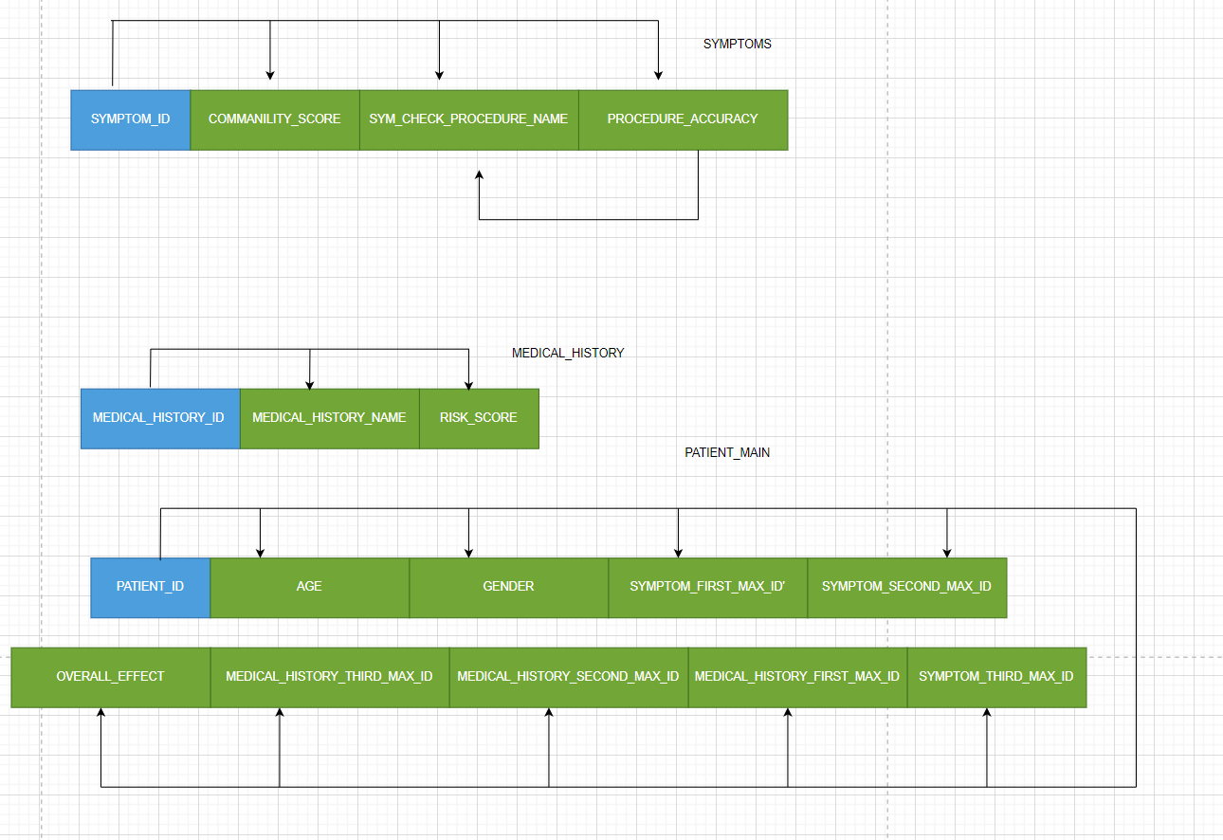
NORMALIZATION
2NF and 3NF
Patient main to medical history and symptoms

Slide 26
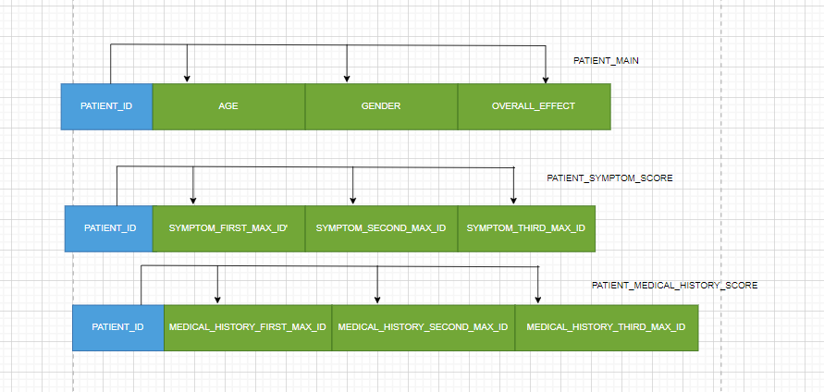
NORMALIZATION
Further division of PATIENT_MAIN
After division addition of new columns is done in both the new tables for scores

Slide 27
NORMALIZATION
Created symptoms and medical history tables
Create surrogate keys in the form of SYMPTOM_ID,MEDICAL_HISTORY_ID as primary keys
These PK’s acts as FK’s in patient main table
Further division is done in symptoms as symptom check table.
SYMPTOM CHECK ID is set as primary key in that table.

Slide 28





DATA ANALYSIS

Slide 29

Research Questions
What are the most frequent symptoms and medical history factors associated with significant health outcomes?
Based on a dataset comprising various symptoms and medical histories, can a statistically significant relationship be established between these factors and the overall health effect as classified into categories like 'Low', 'Medium', and 'High’?
What are the potential effects of excluding certain demographic features from a predictive model on its ability to accurately classify different categories?

Slide 30
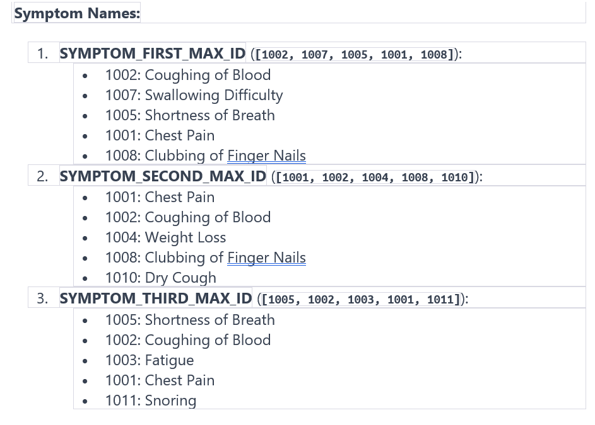
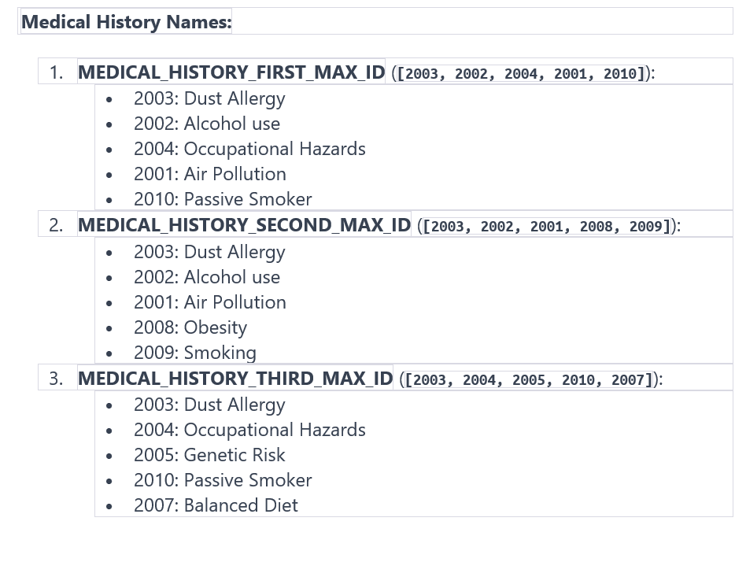
What are the most frequent symptoms and medical history factors associated with significant health outcomes?

Slide 31
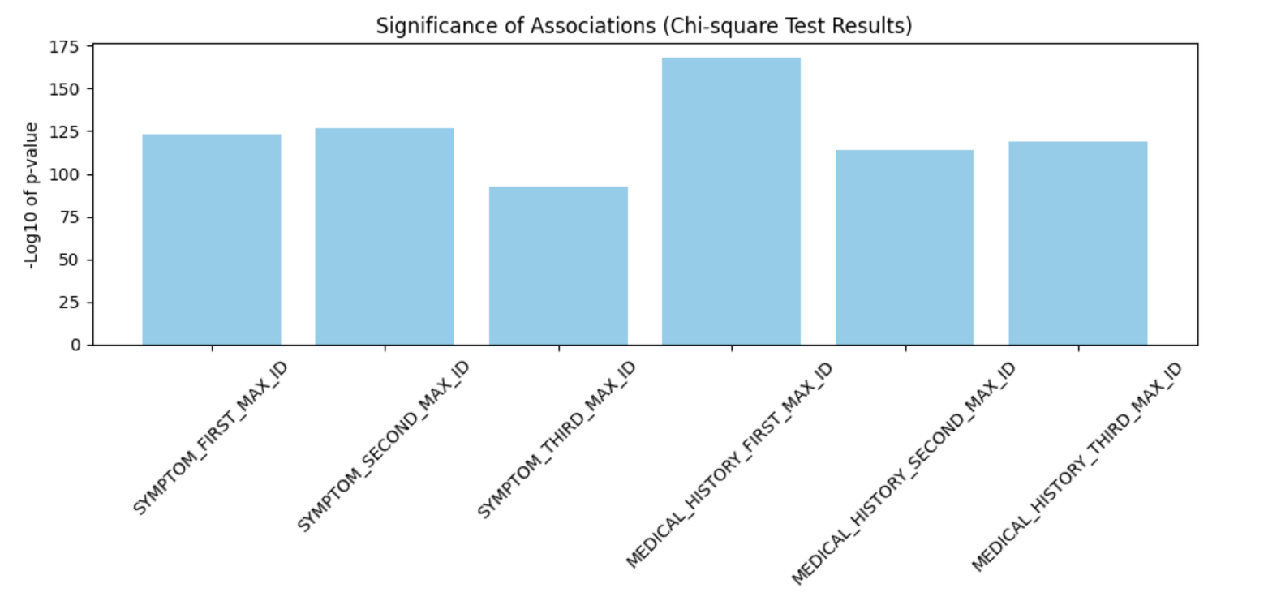
Based on a dataset comprising various symptoms and medical histories, can a statistically significant relationship be established between these factors and the overall health effect as classified into categories like 'Low', 'Medium', and 'High’?
STATISTICALLY SIGNIFICANT
YES ,the p value is above 0.05 for all

Slide 32
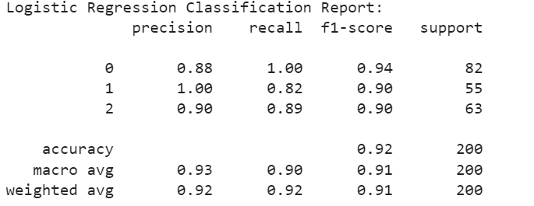
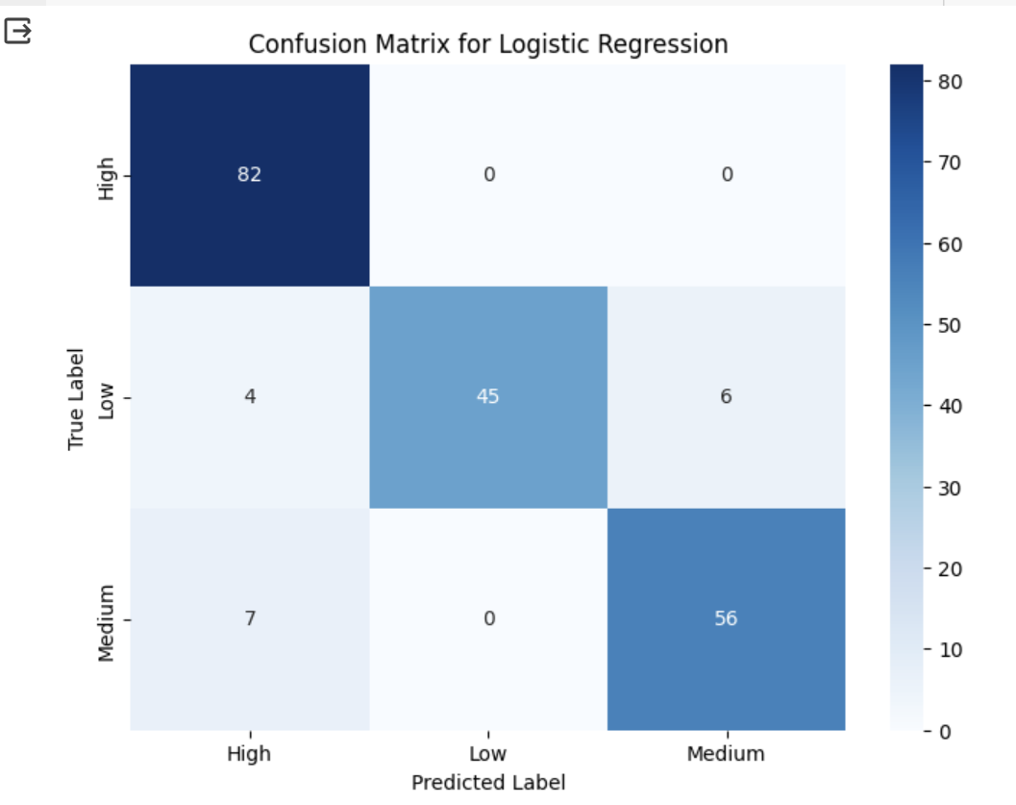
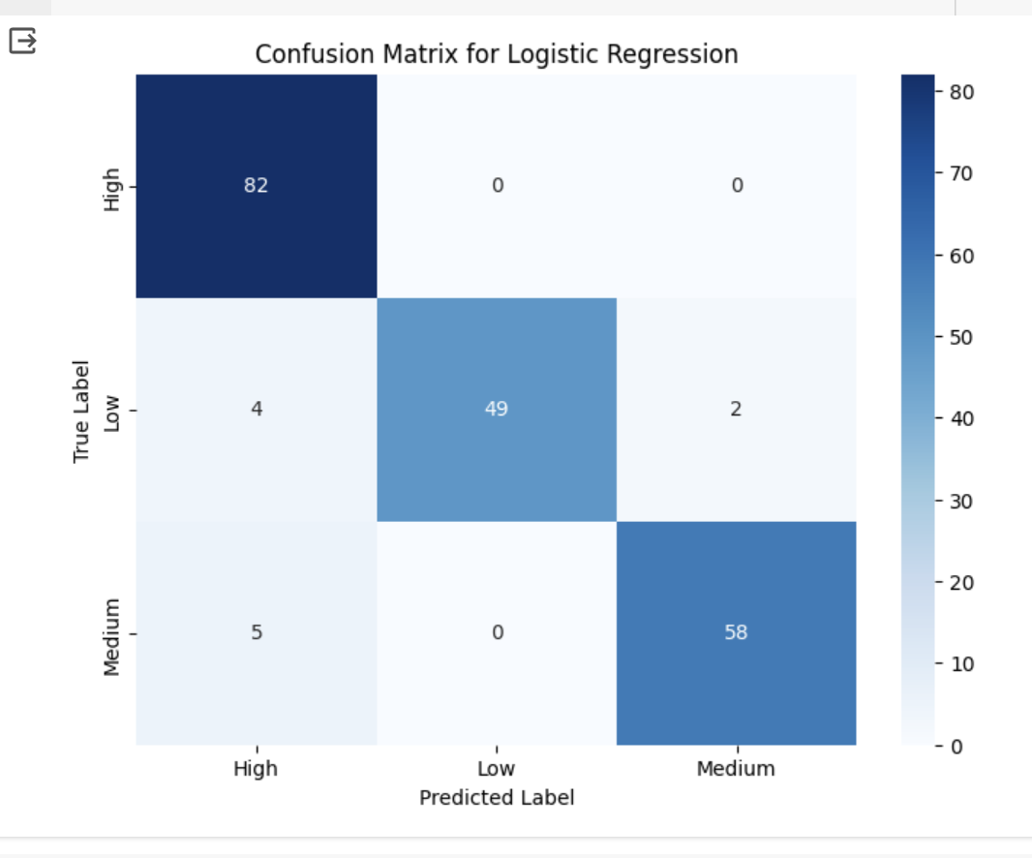
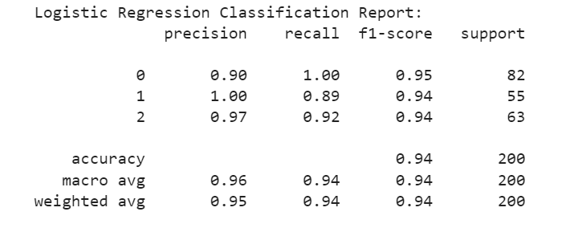
What are the potential effects of excluding certain demographic features from a predictive model on its ability to accurately classify different categories?
Logistic regression Report Before adding age and gender
After Addition of AGE AND GENDER
BEFORE Addition of AGE AND GENDER
Logistic regression Report after adding age and gender

Slide 33
SQL QUESTIONS
What is the commonality score for patient who has patient_ID of P125?
Which procedure is applied for patient having ID P114 for his most effective symptom?

Slide 34
What is the commonality score for patient who has patient_ID of P125?
SELECT commonality_score
FROM symptoms
JOIN patient_symptom_score ON patient_symptom_score.SYMPTOM_FIRST_MAX_ID = symptoms.SYMPTOM_ID
WHERE PATIENT_SYMPTOM_SCORE.PATIENT_ID = 'P125’;
Ans : the commonality score for patient who has patient_ID of P125 is 7

Slide 35
Which procedure is applied for patient having ID P114 for his most effective symptom?
SELECT procedure_name
FROM SYMPTOM_CHECK
JOIN symptoms sy ON sy.SYMPTOM_CHECK_PROCEDURE_ID = symptom_check.SYMPTOM_CHECK_PROCEDURE_ID
JOIN patient_symptom_score ON patient_symptom_score.SYMPTOM_FIRST_MAX_ID = sy.SYMPTOM_ID
WHERE patient_symptom_score.PATIENT_ID = 'P114’;
Ans: Procedure applied for patient having ID P114 for his most effective symptom is “BLOOD TESTS”

Slide 36
MIDTERM FEEDBACK IMPLEMENT
More elaboration of ERD is done
Simple and efficient Normalization process
Addition of Triggering elements in SQL
Implementation of Machine learning algorithm
Simple addition of surrogate keys

Slide 37

CHALLENGES
Elimination of Data redundancy is a bigger task
Getting the idea of new columns that supports our objective
Correct Design of ERD and their relations (DRAW.IO)
Optimization of the Code for data analysis
Achieving 3NF and 2NF as there are no partial dependencis
Identifying compact visualizations to make the objective interpretable

Slide 38

FUTURE WORK
Addition of different columns can be done like their emotional score etc.
Addition of more rows can be done to achieve good regression and chi square analysis
Addition of different triggers can be done for different tables
Can do advance normalization like BCNF(3.5 NF)

Slide 39

END

